Slide 1

International DX Convention
Visalia, CA – April 2016

Slide 2
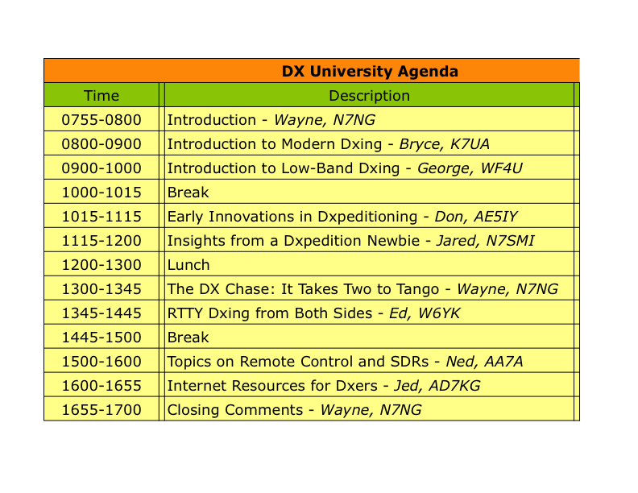

Slide 3
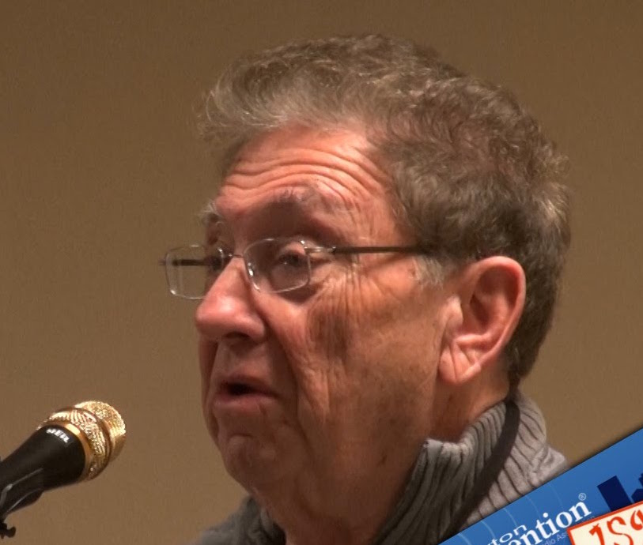
Don Miller AE6IY
Early Innovations in Dxpedition Operating

Slide 4
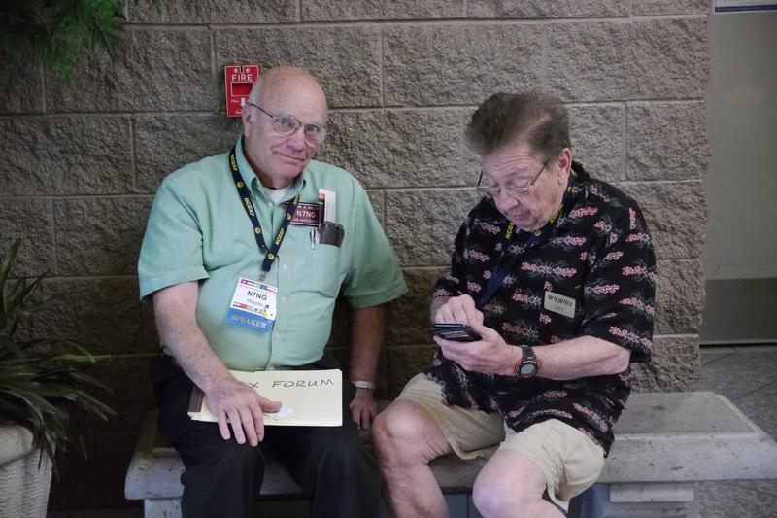
Don Miller AE6IY
A few words about Don Miller and his innovations:
Arguably created the modern pileup style of operating.
Rapid-fire QSOs.
Started the“5NN” QSO.
Pileup management – Split operation
Was an advocate of “tail-ending,” and very competent in using it.
“Operated” a little on the edge…(maybe a lot)
Don Miller in Visalia, 2015

Slide 9


